Slide 1









Validation
Confusion Matrix, Accuracy, Precision, Recall
Nirvana Fanaealhi
nirvana.elahi@outlook.com

Slide 2
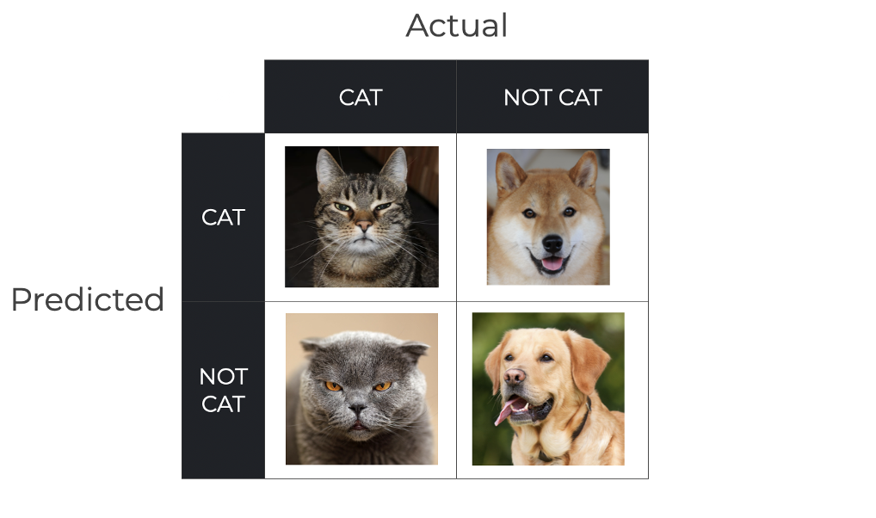
confusion matrix
foundational tool for evaluating classification models, providing a breakdown of true positives, true negatives, false positives, and false negatives to reveal prediction patterns beyond simple accuracy

Slide 3
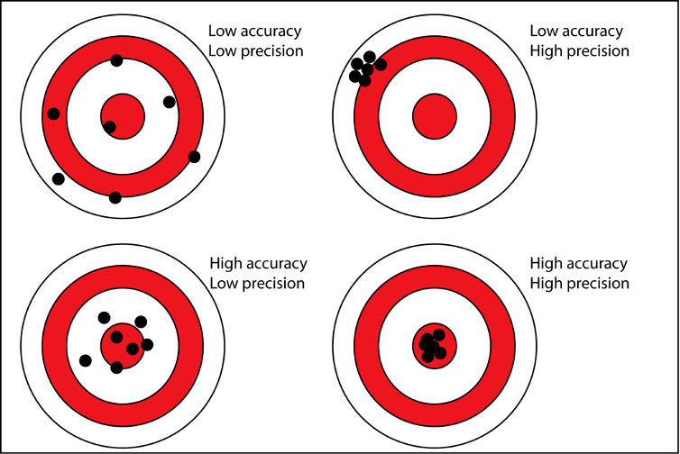
Accuracy
measures the overall fraction of correct predictions, but it can be misleading in imbalanced datasets where one class dominates

Slide 4
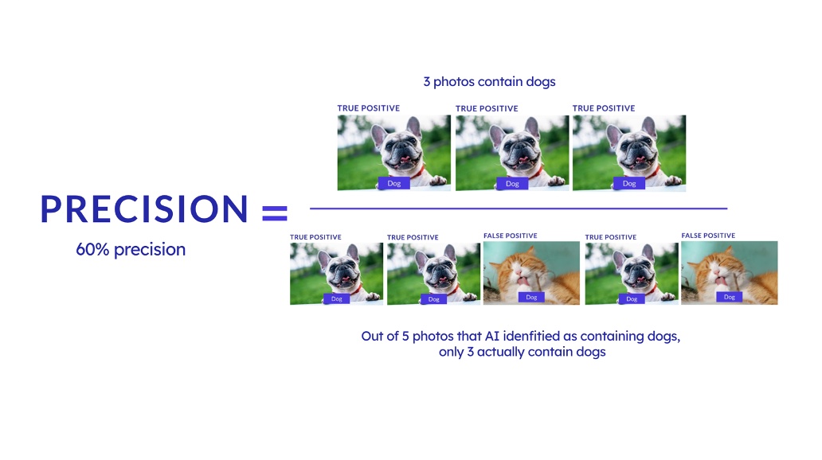
Precision
focuses on the reliability of positive predictions, helping in scenarios where false positives carry high costs, such as spam detection

Slide 5
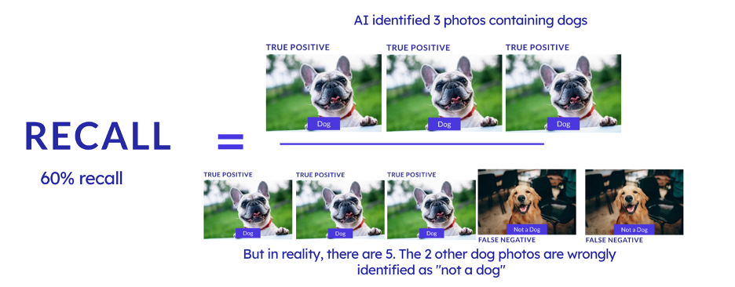
Recall
capturing all actual positives, which is crucial in applications like medical diagnostics where missing cases (false negatives) could be harmful

Slide 6

Accuracy:
(TP + TN) / (TP + TN + FP + FN) – A straightforward measure, but use cautiously in imbalanced scenarios
Precision:
TP / (TP + FP) – Prioritizes minimizing false alarms
Recall:
TP / (TP + FN) – Aims to reduce missed detections

Slide 7
Projects Sample
https://github.com/ties2/SentiSocial

Slide 8
Thank
you!

